Slide 1
CondoR
Generation of Miracles – Makati
Abaya, Manuel | Cerbo, Cheneil
Comia, Monica | Villanueva, Jose Lorenzo

Slide 2
What is CondoR?
The CondoR (short for Condominium Registration) application is a condominium visitor management system
It is developed to manage data and minimize the time taken for visitor logging, upon entering and leaving the condominium.
The system replaces the manual on-paper system of logging in and out of a condominium.

Slide 3
Using CondoR

Slide 4
WELCOME WINDOW
The system will greet you with the WELCOME window
Clicking the ACCOUNT LOG IN button will lead you to the LOG IN window
Clicking the EXIT button will issue a prompt to exit the application

Slide 5
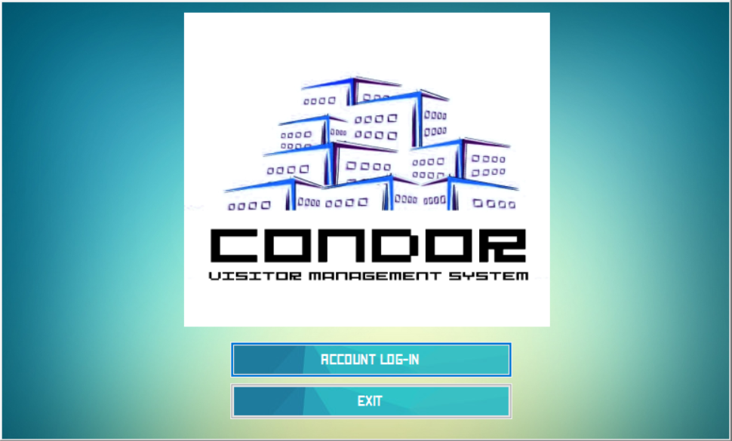

Slide 6
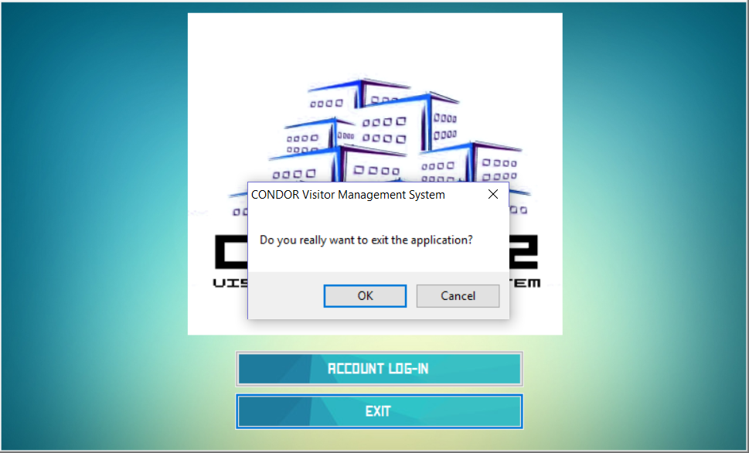

Slide 7
USER LOGIN WINDOW
The application requires user credentials registered in the database to fully access the system
Entering an invalid username and/or password -> prompt that will inform the user that his/her credentials are invalid.
Entering correct credentials will access the system depending on which type of user account was entered

Slide 8
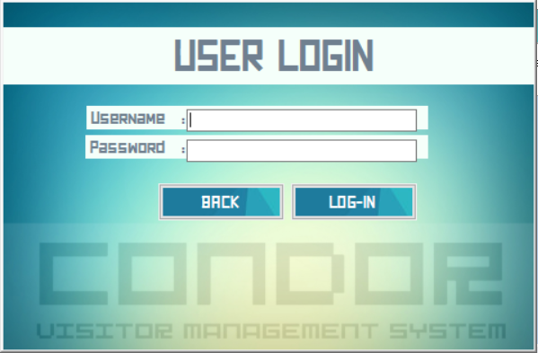

Slide 9
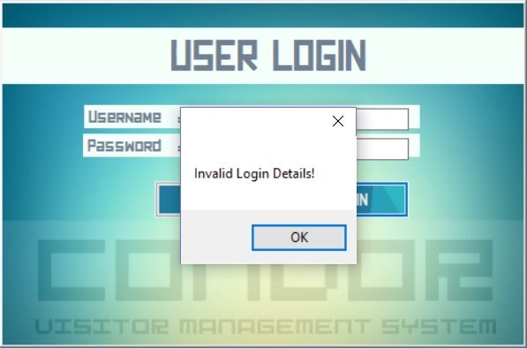

Slide 10
USERS
There are 2 types of users for this application:
Administrator
Facilitator

Slide 11
FACILITATOR MANAGEMENT
Upon log in with the ADMINISTRATOR CREDENTIALS
The application will show a Administrator-exclusive window
To manage the Facilitators currently recognized by the system

Slide 12
FACILITATOR ACCOUNT LIST WINDOW
A list of all the facilitator accounts, user names and passwords currently registered in the system
Has the buttons for creating, updating and deleting Facilitator accounts

Slide 13
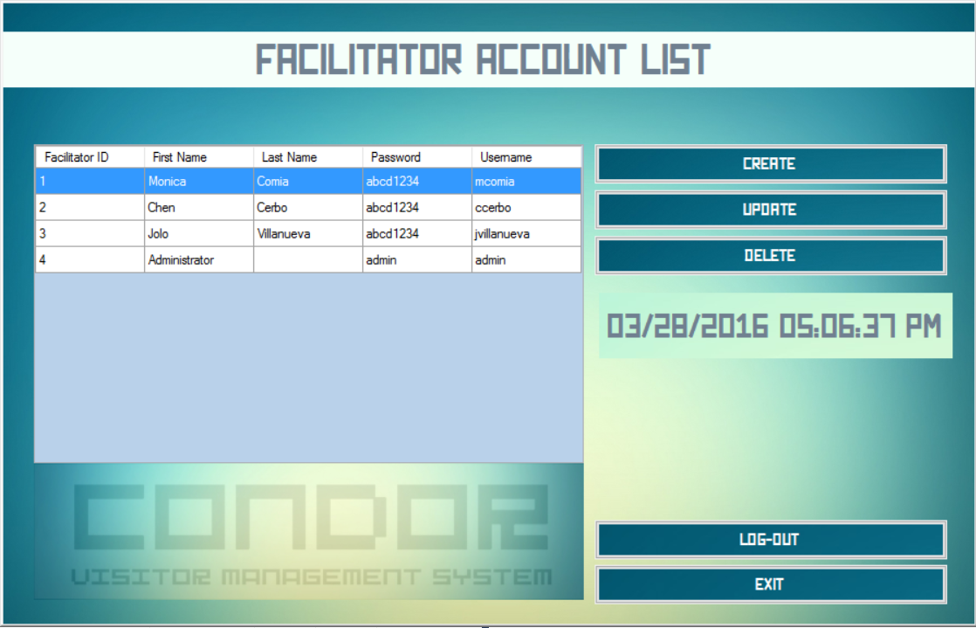

Slide 14
FACILITATOR ACCOUNT LIST WINDOW
The CREATE button leads to...
Facilitator Create Window - A window with form fields to create a Facilitator account that will be registered into the system

Slide 15
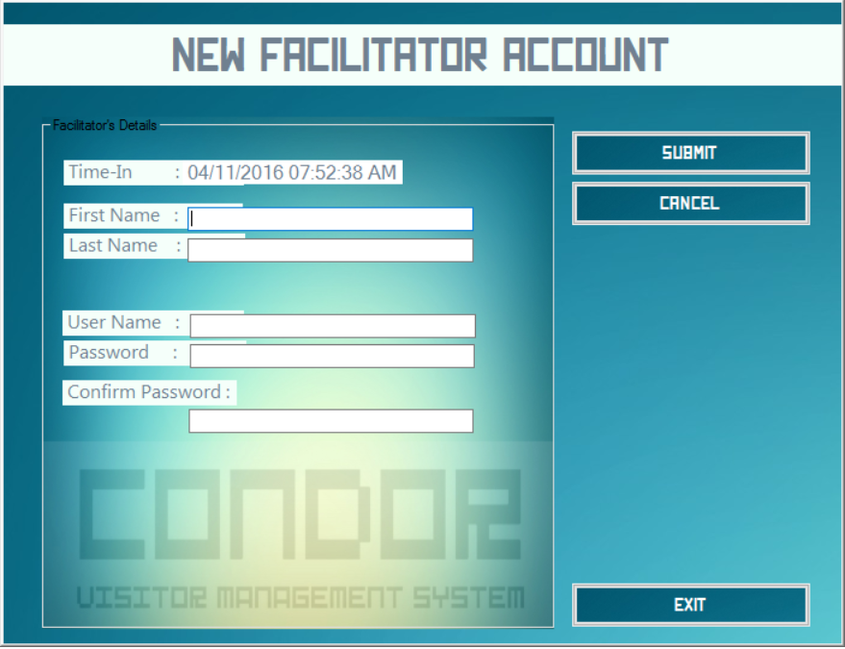

Slide 16
NEW FACILITATOR ACCOUNT WINDOW
The SUBMIT button will verify the fields (if there are any empty fields) and create the Facilitator account
The CANCEL button will return you to the facilitator list without submitting the form
The EXIT button will issue a prompt to exit the application

Slide 17
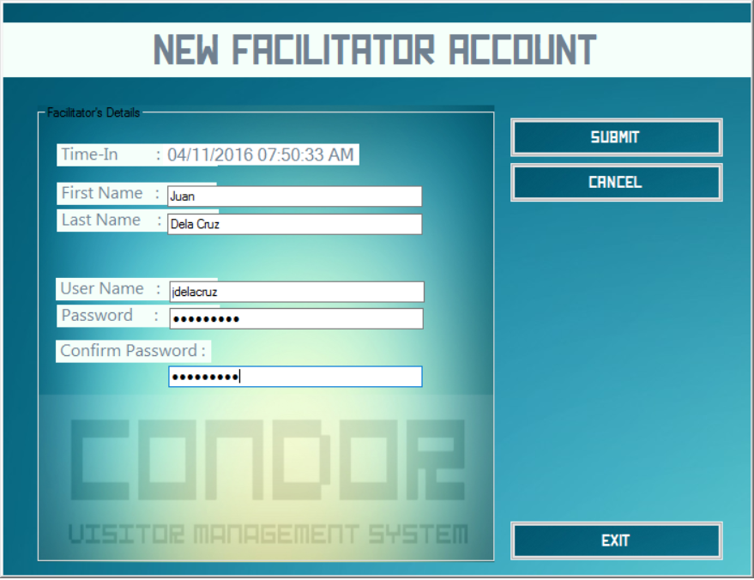

Slide 18
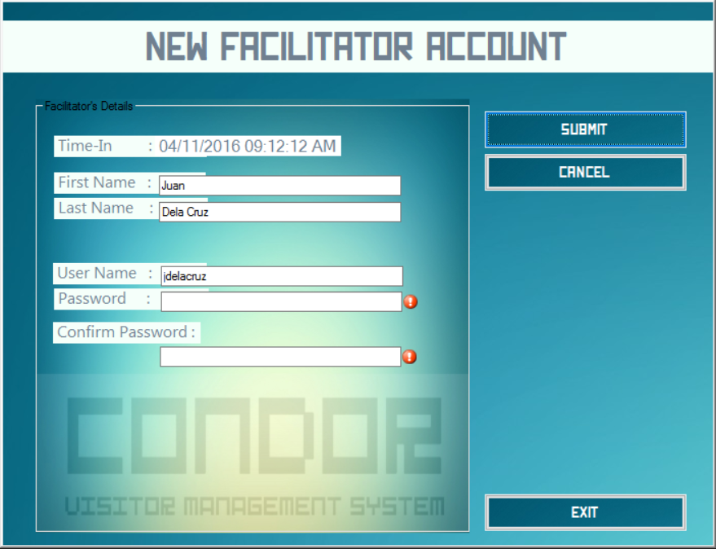

Slide 19
FACILITATOR ACCOUNT LIST WINDOW
The UPDATE button leads to...
Facilitator Update Window - A window with populated form fields (based on the selected account from the list) to update a Facilitator account currently registered in the system

Slide 20
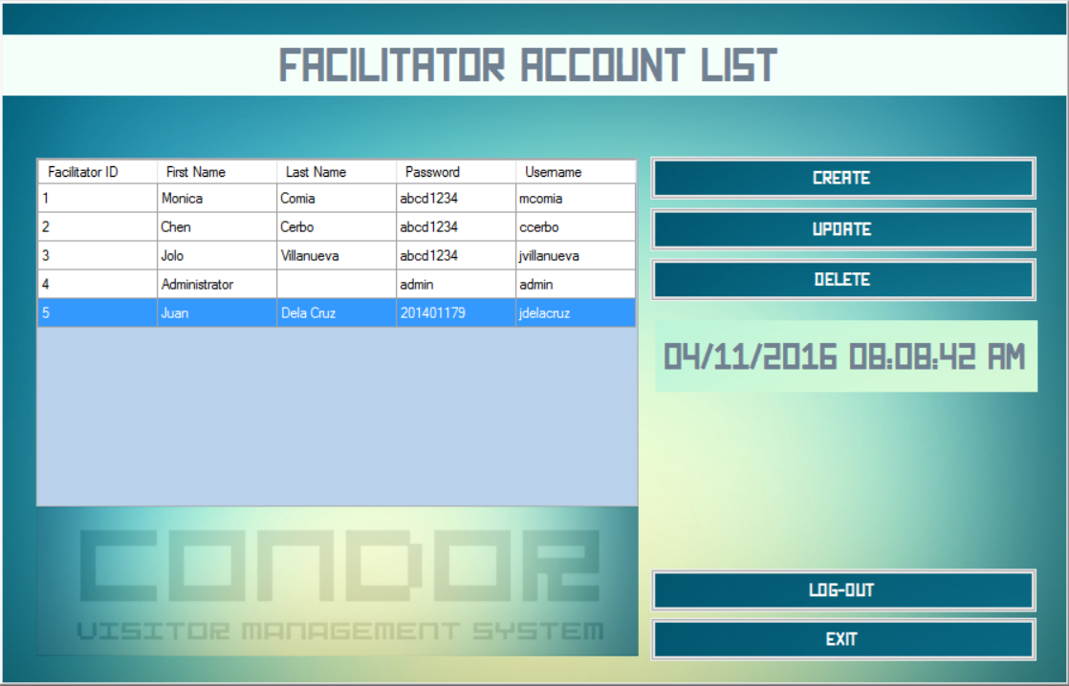

Slide 21
UPDATE FACILITATOR ACCOUNT WINDOW
The UPDATE button will verify the form fields and update the corresponding Facilitator record
The CANCEL Button will return you to the facilitator list without any changes to the record
The EXIT button will issue a prompt to exit the application

Slide 22
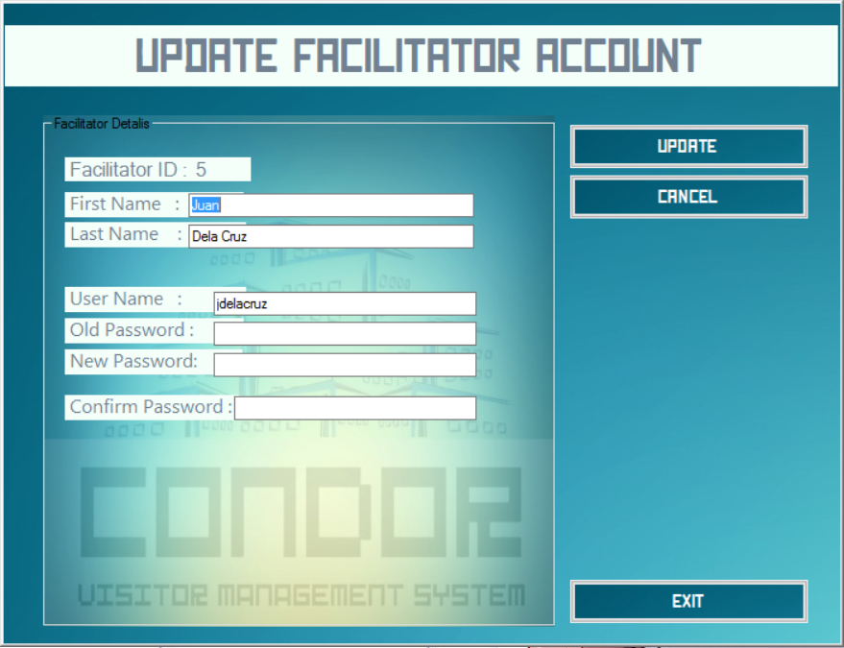

Slide 23
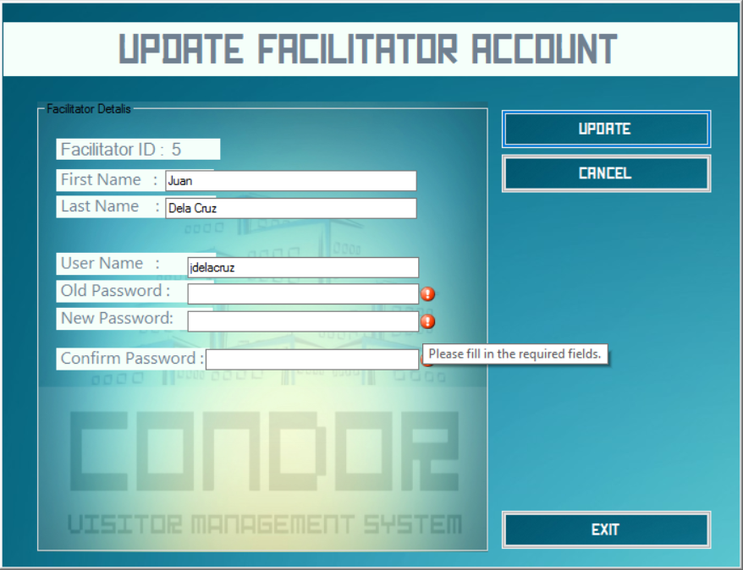

Slide 24
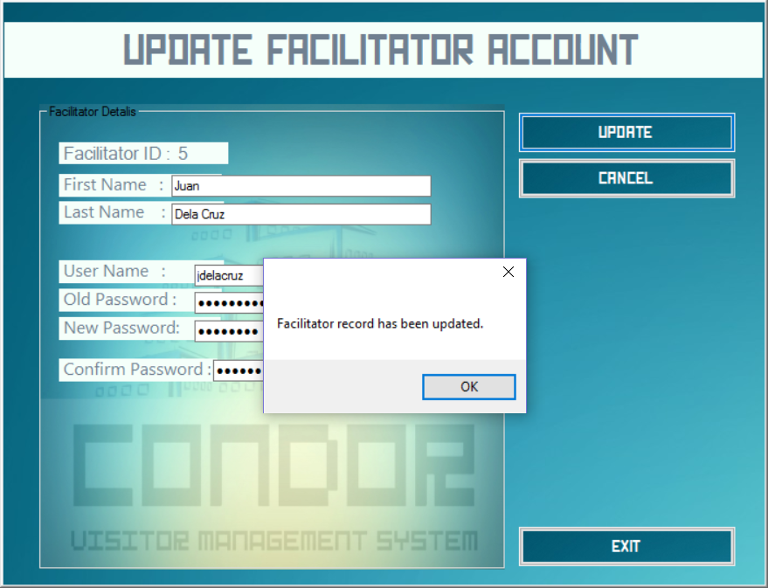

Slide 25
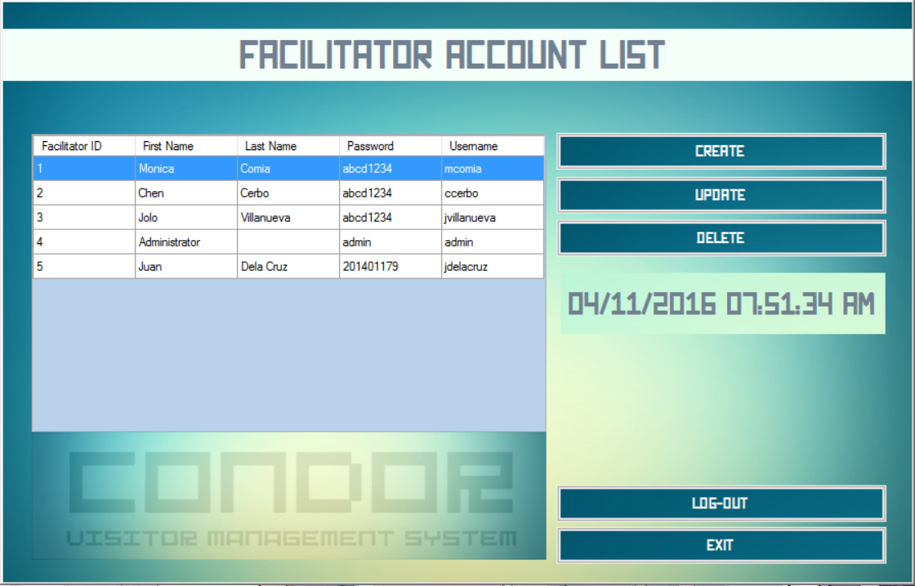

Slide 26
FACILITATOR ACCOUNT LIST WINDOW
The DELETE button will issue a prompt asking for verification to delete the record from the system database.
If 'Yes' is clicked, the selected record will be deleted
If 'No' is clicked, no action will be taken

Slide 27
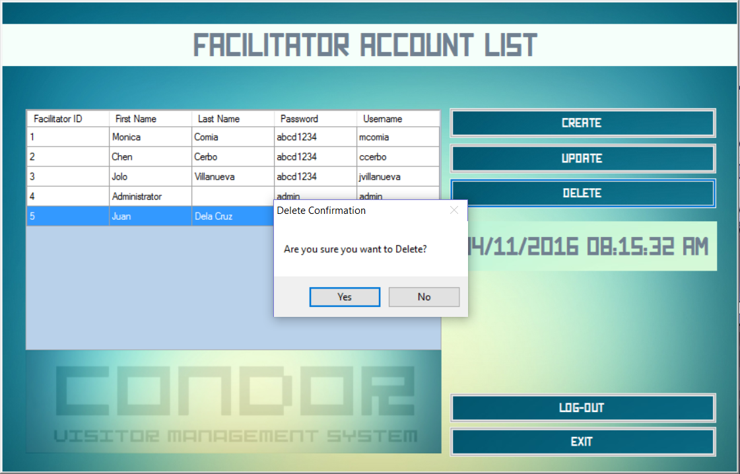

Slide 28
FACILITATOR ACCOUNT LIST WINDOW
The LOG-OUT button will issue a prompt to log-out of the system.
'Yes' will put you back at the Log-in window
'No' cancels the prompt and takes no action.

Slide 29
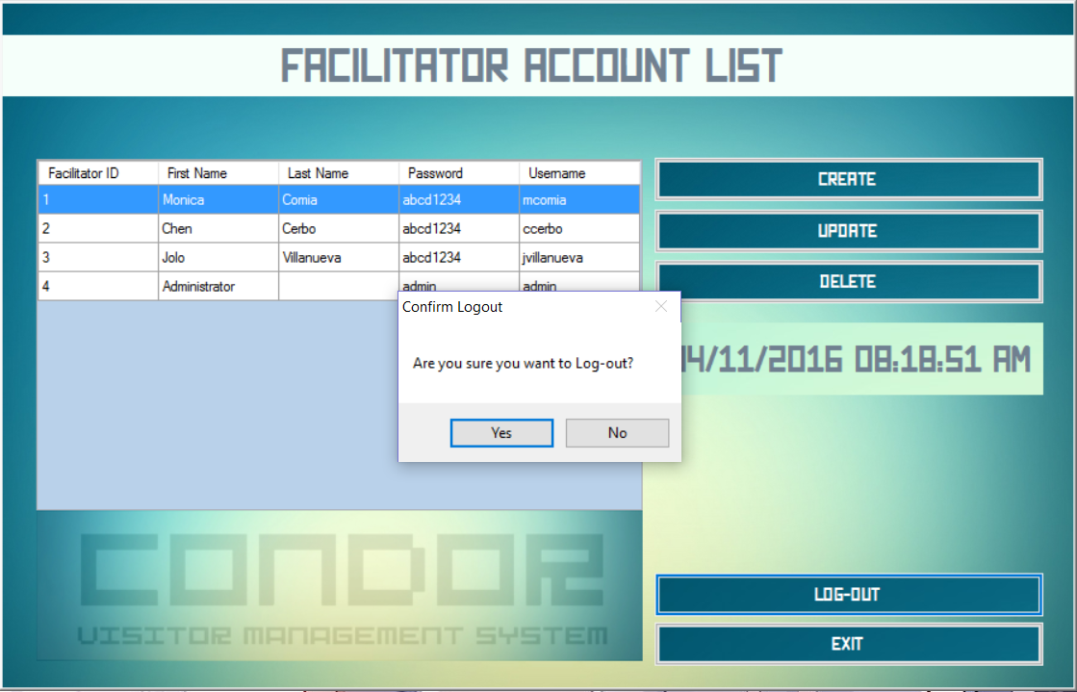

Slide 30
VISITOR MANAGEMENT
Upon log-in with FACILITATOR CREFENTIALS
The application will lead to the VISITOR CREATE window where there are fields to enter a visitor into the system

Slide 31
VISITOR REGISTRATION WINDOW
The SUBMIT button will verify the form fields and add the visitor into the system
The VIEW LIST Button will lead to the VISITOR LIST Window
The LOG-OUT button will issue a prompt to log-out the system and return to the LOG IN window
The EXIT button will issue a prompt to exit the application

Slide 32
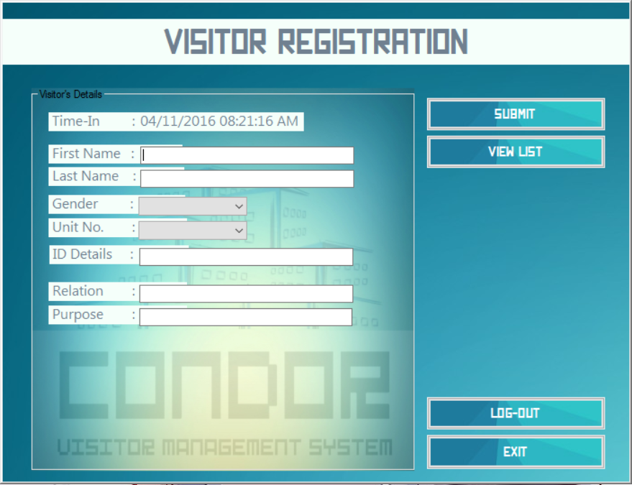

Slide 33
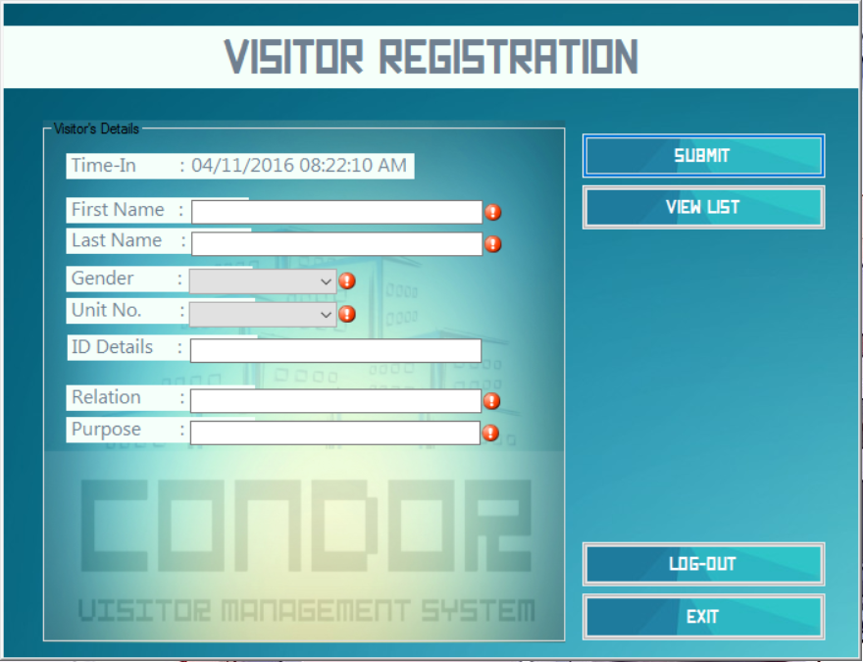

Slide 34
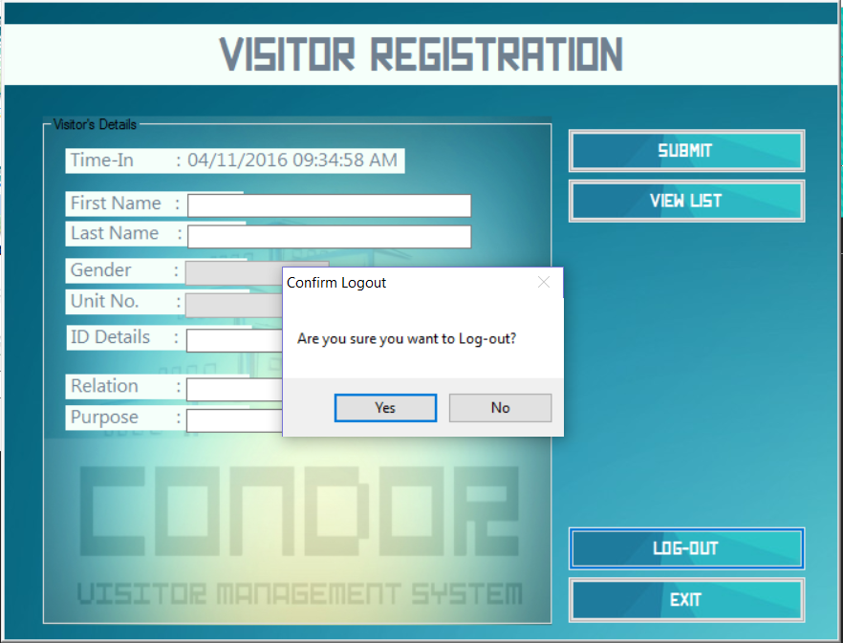

Slide 35
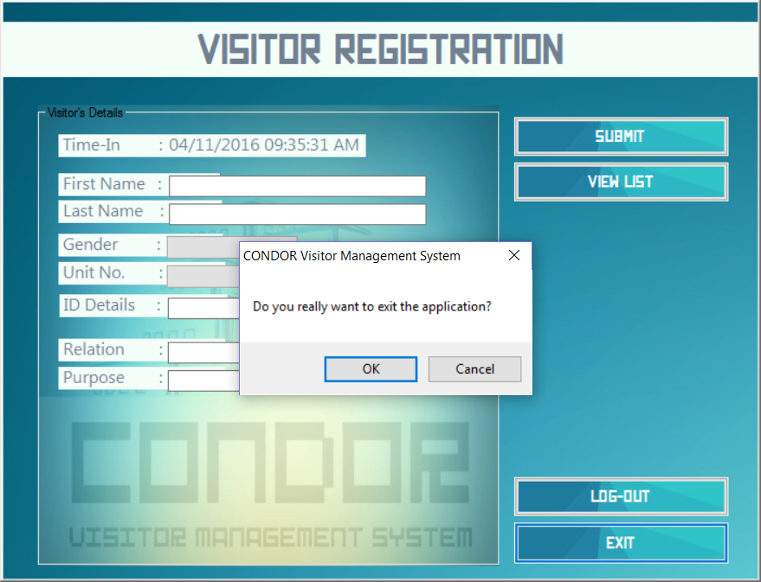

Slide 36
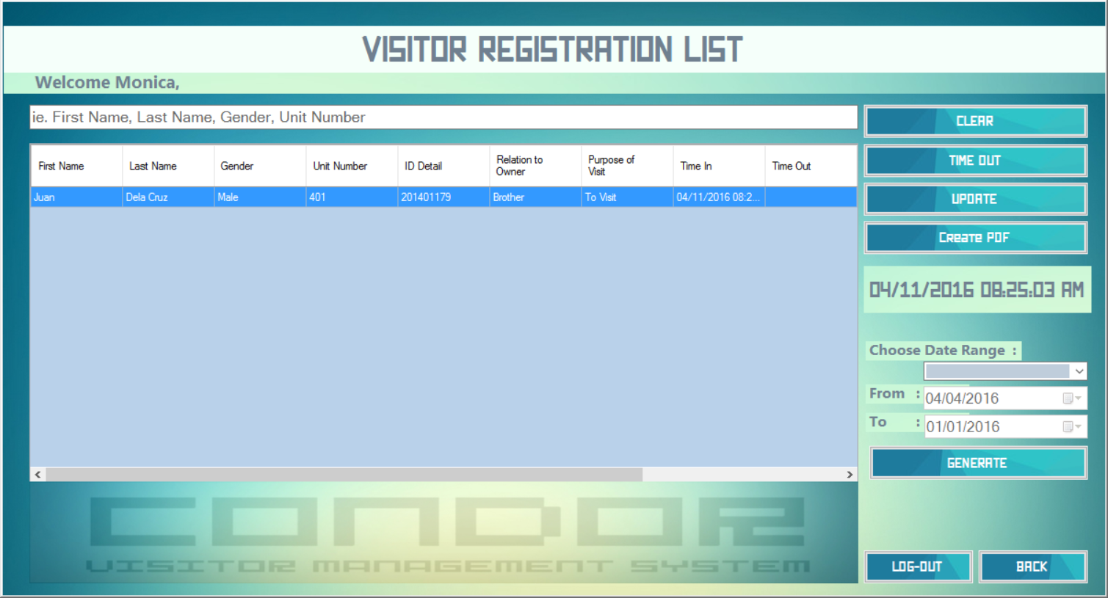

Slide 37
VISITOR REGISTRATION LIST WINDOW
A SEARCH BAR is located near the top of the window. It can be used to search any specific visitor record needed by the user.

Slide 38
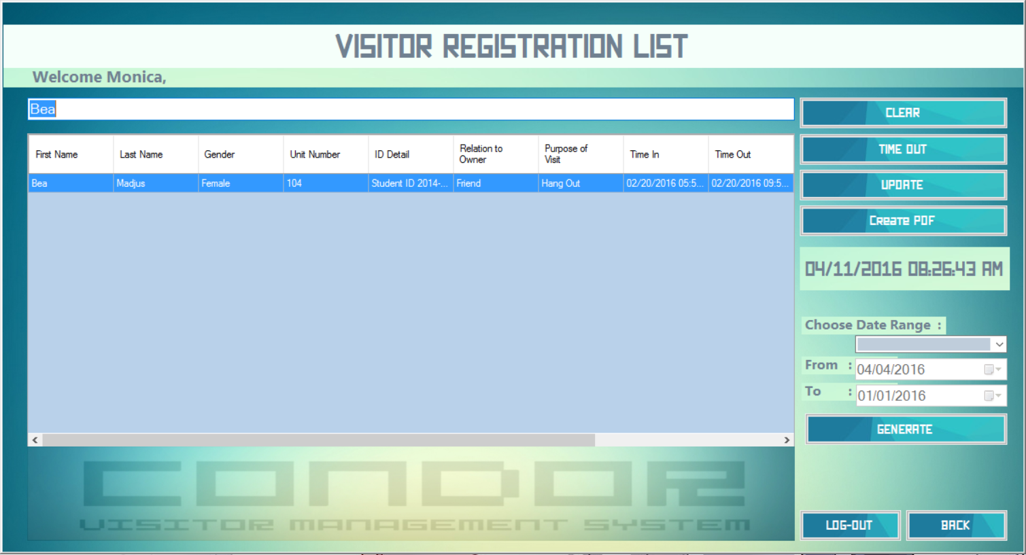

Slide 39
VISITOR REGISTRATION LIST WINDOW
The UPDATE button leads to...
Visitor Update Window - A window with populated form fields (based on the selected account from the list) to update a visitor account currently logged in the system

Slide 40
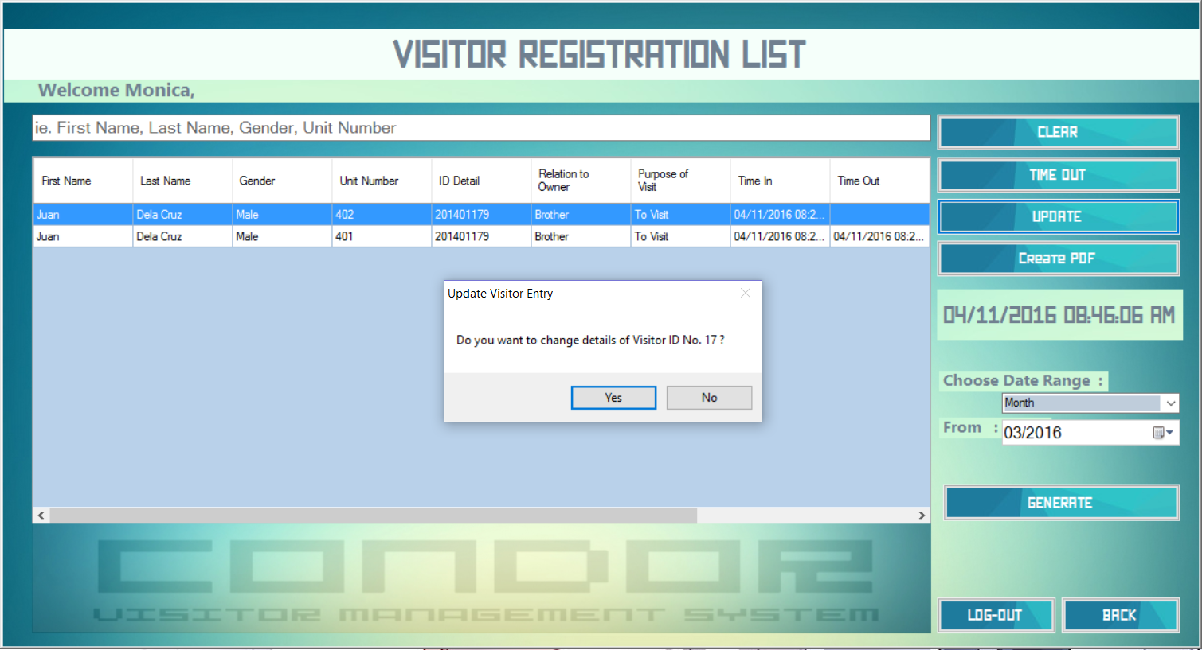

Slide 41
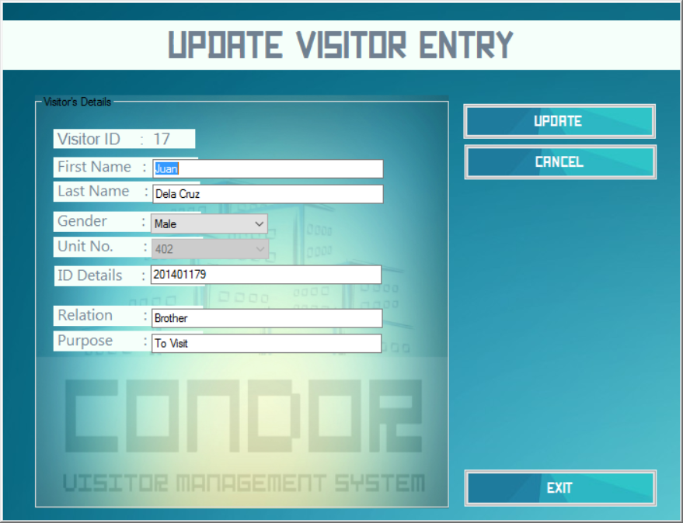

Slide 42
UPDATE VISITOR ENTRY WINDOW
The UPDATE button will verify the form fields and update the corresponding Visitor record
The CANCEL Button will return you to the visitor list without any changes to the record
The EXIT button will issue a prompt to exit the application

Slide 43
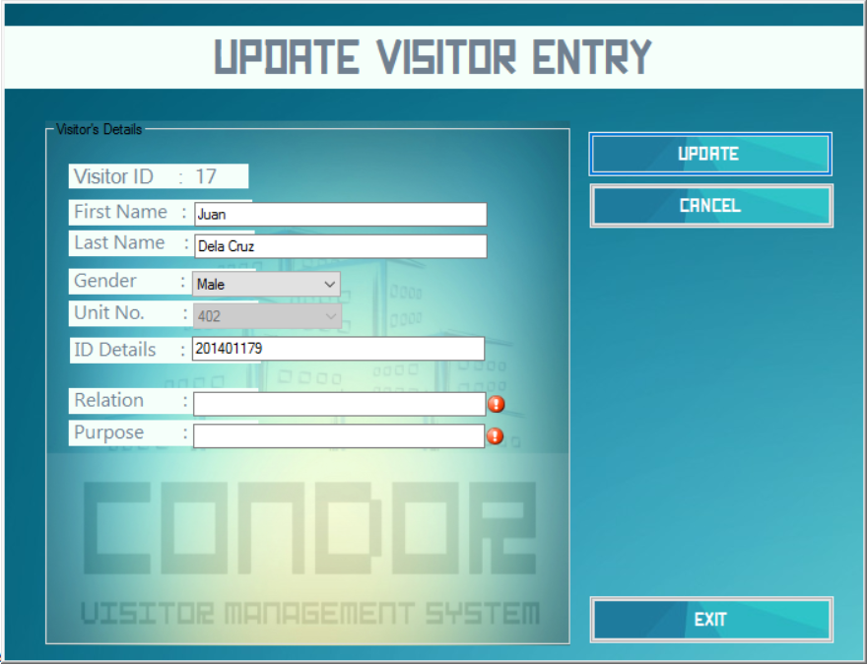

Slide 44
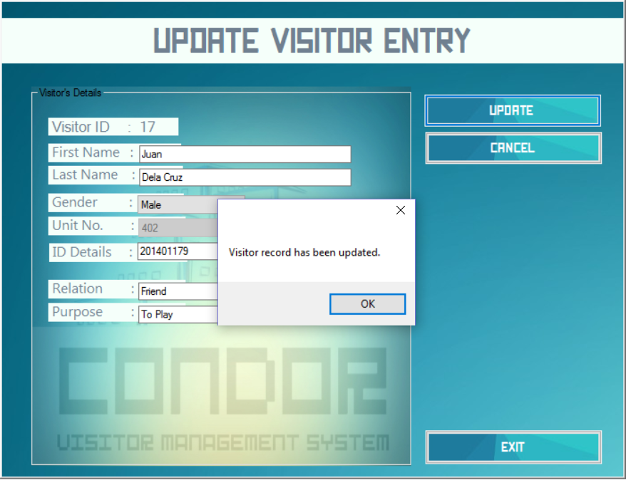

Slide 45
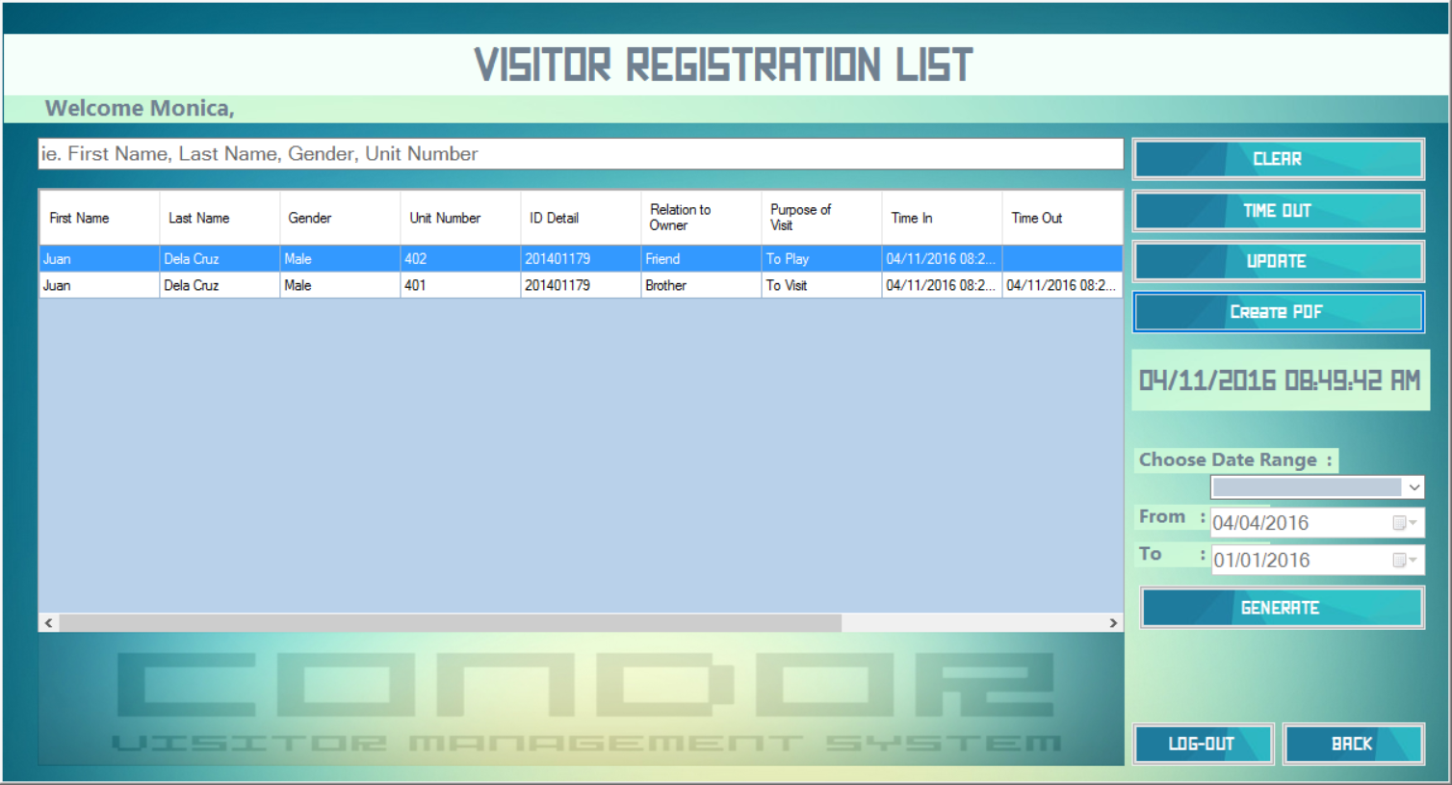

Slide 46
GENERATE PDF REPORT WINDOW
The CREATE PDF button leads to...
A window with options to generate a list of visitors within a given timeframe. The system can generate pdf files of daily, weekly and monthly reports

Slide 47
GENERATE PDF REPORT WINDOW
Clicking the GENERATE PDF button will check the form fields in the window and a dialog box will appear, asking the user the file name and file path. CondoR will then generate and open the report to be viewed by the user.
Clicking the BACK button will return the user to the visitor list window.

Slide 48
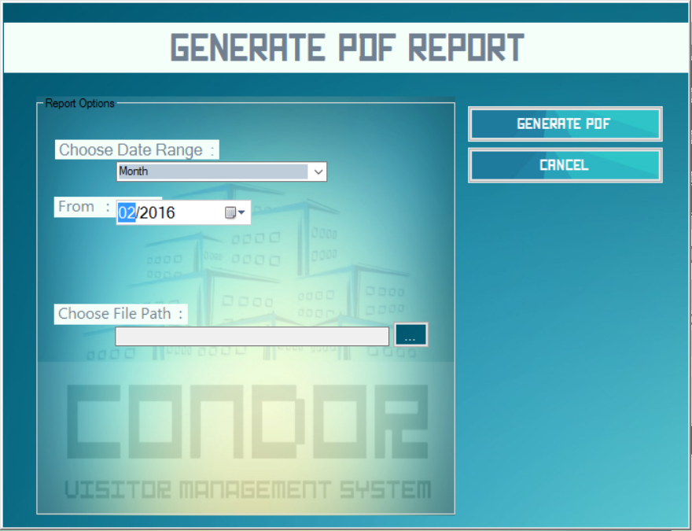

Slide 49
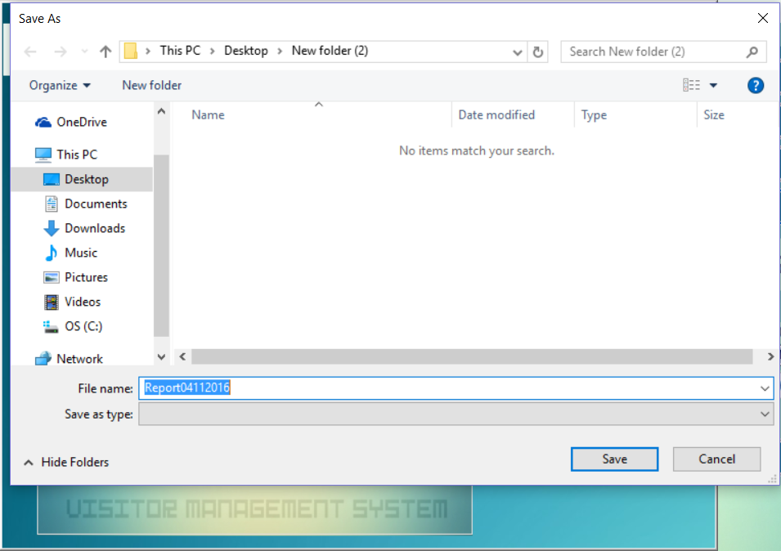

Slide 50
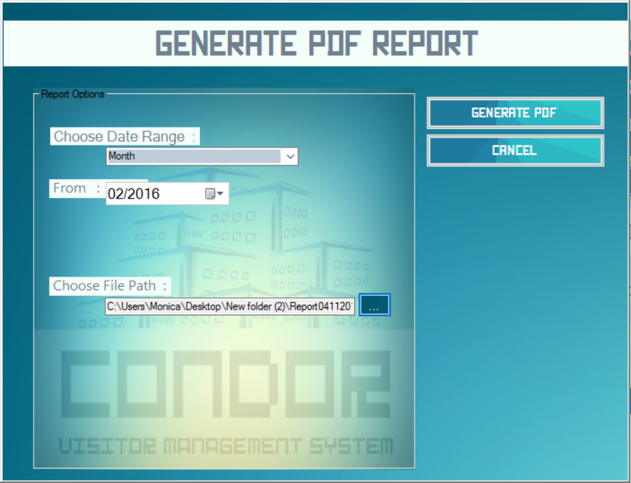

Slide 51
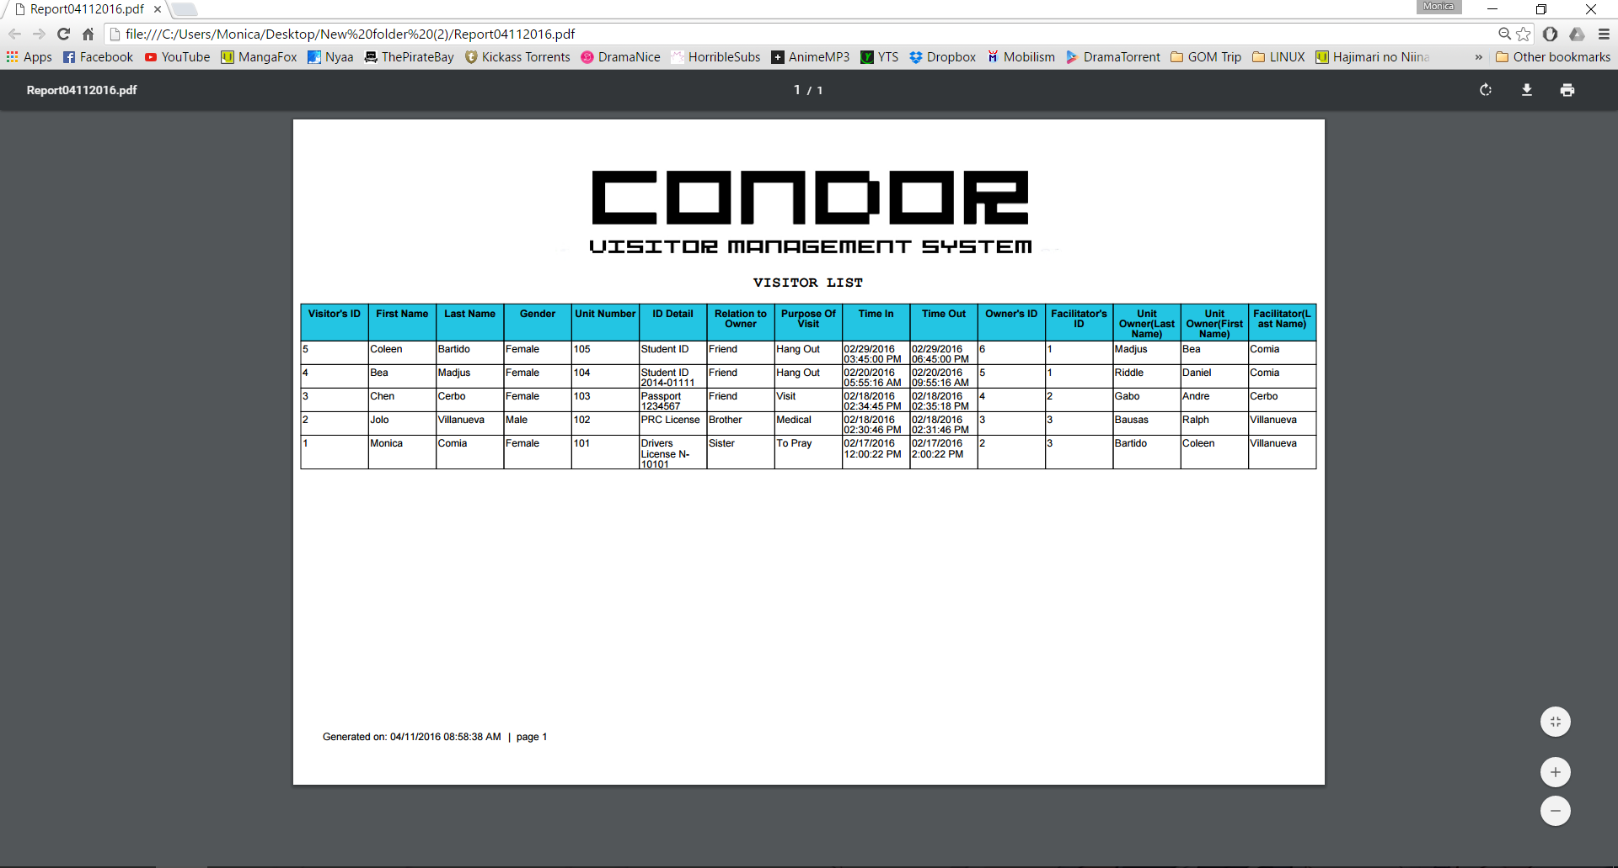

Slide 52
VISITOR REGISTRATION LIST SORT
Sorts the records in the system that will be displayed by the table
Most recent entries are sorted first

Slide 53
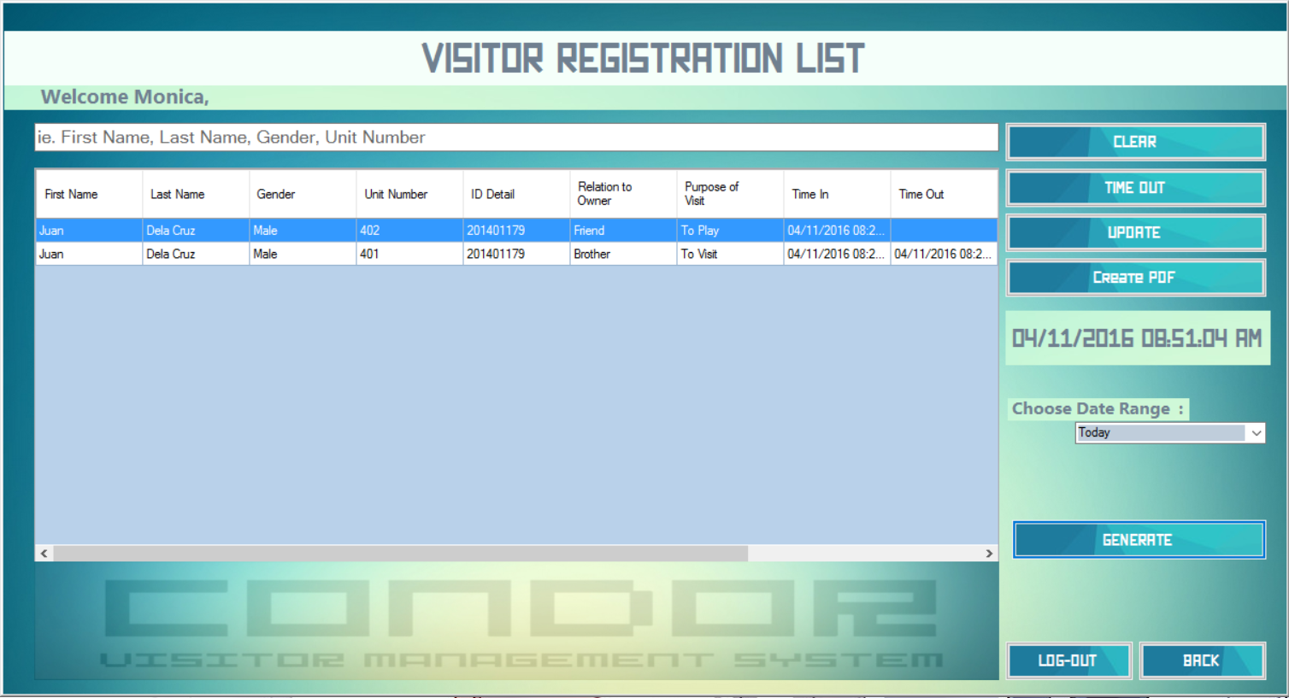

Slide 54
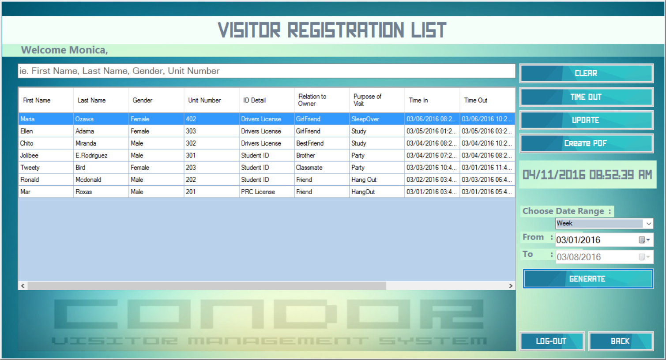

Slide 55
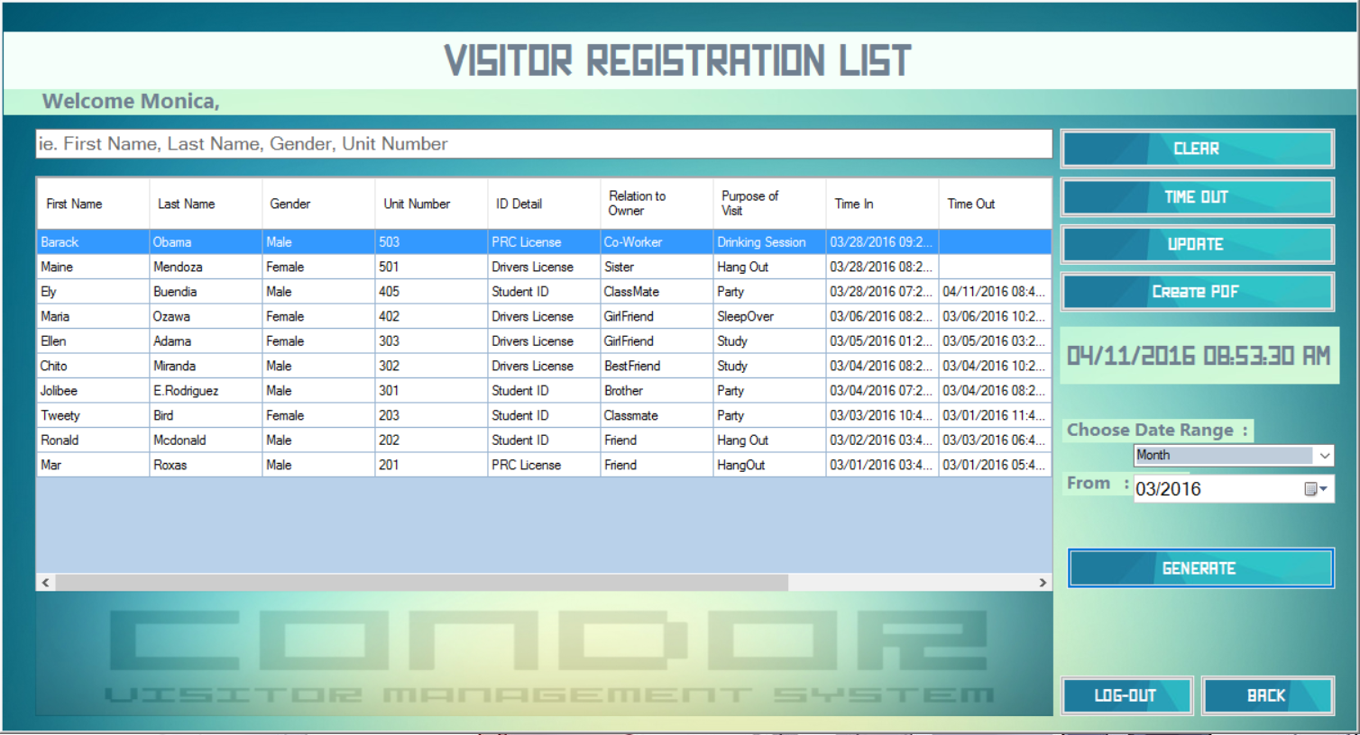

Slide 56
VISITOR REGISTRATION LIST WINDOW
The TIME OUT button takes the currently selected record and updates with the current time in the time-out column of the database.
If the record has already timed out, button is disabled.
The LOG OUT button will close the visitor list window and log the user out of the system. It will return the user to the Log in window.

Slide 57
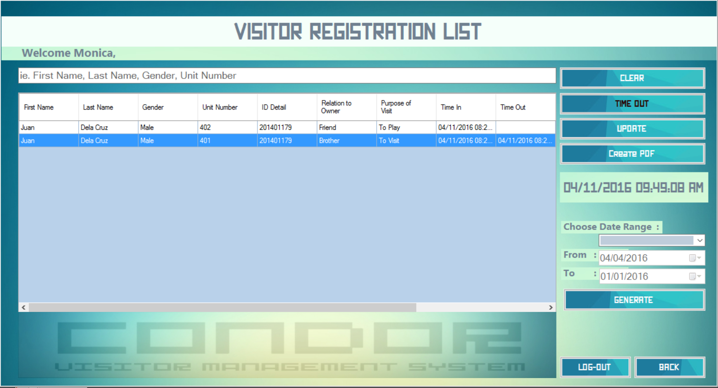

Slide 58
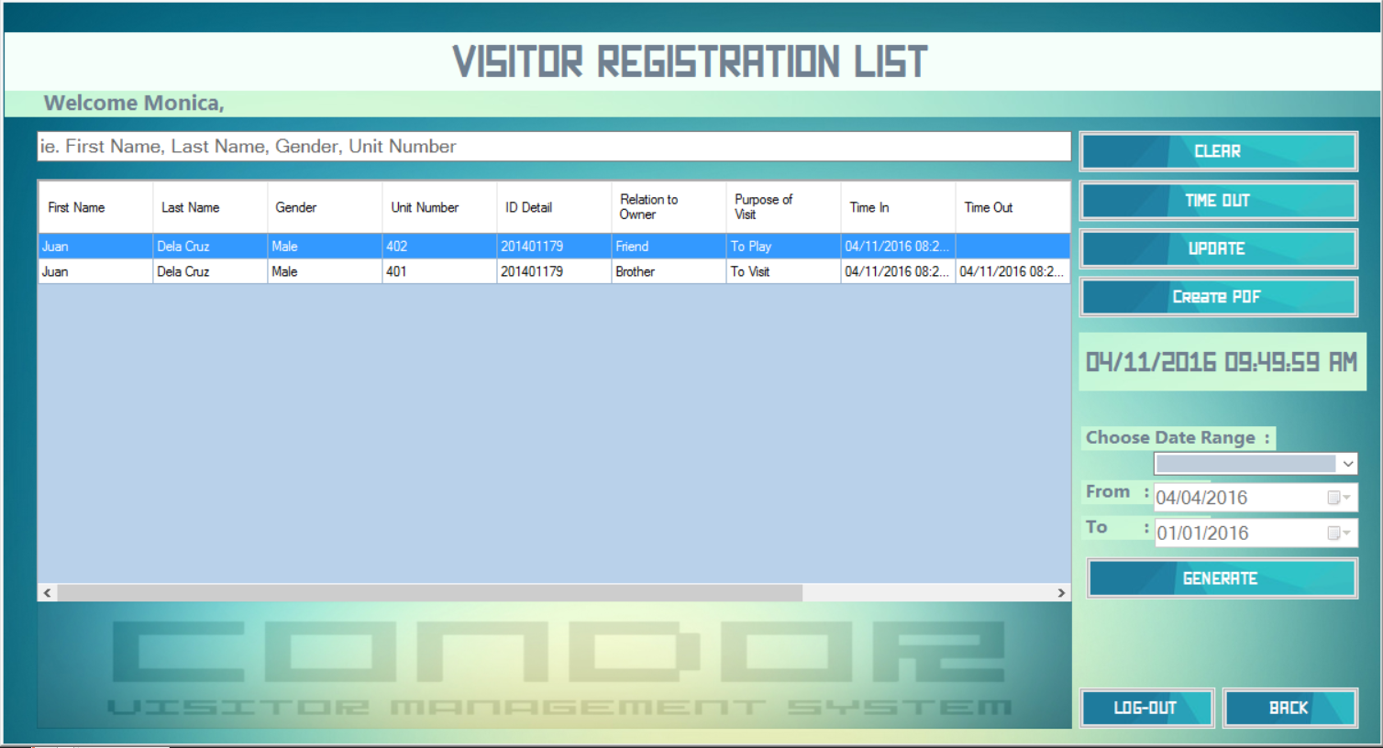

Slide 59
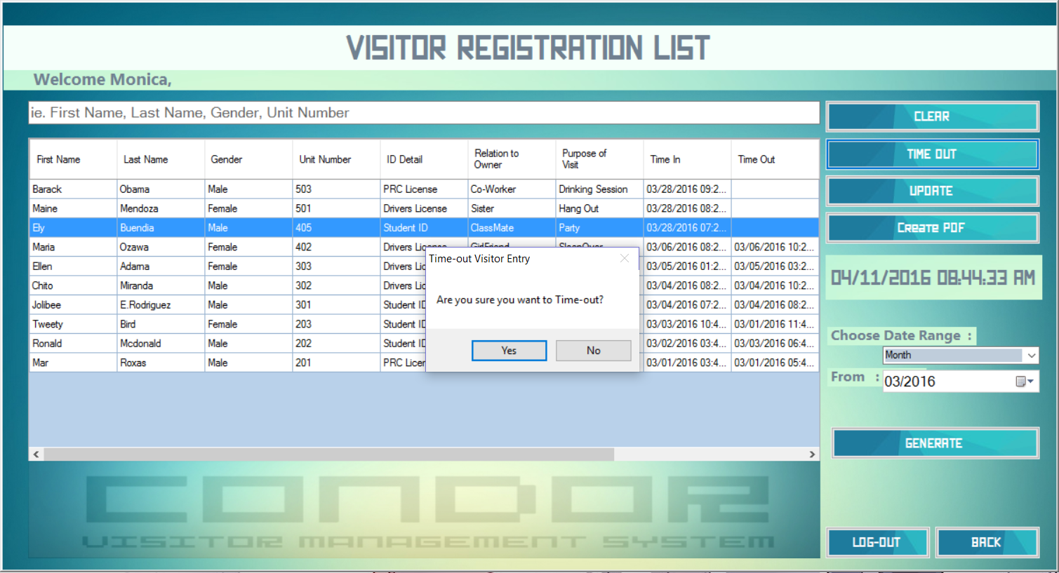

Slide 60
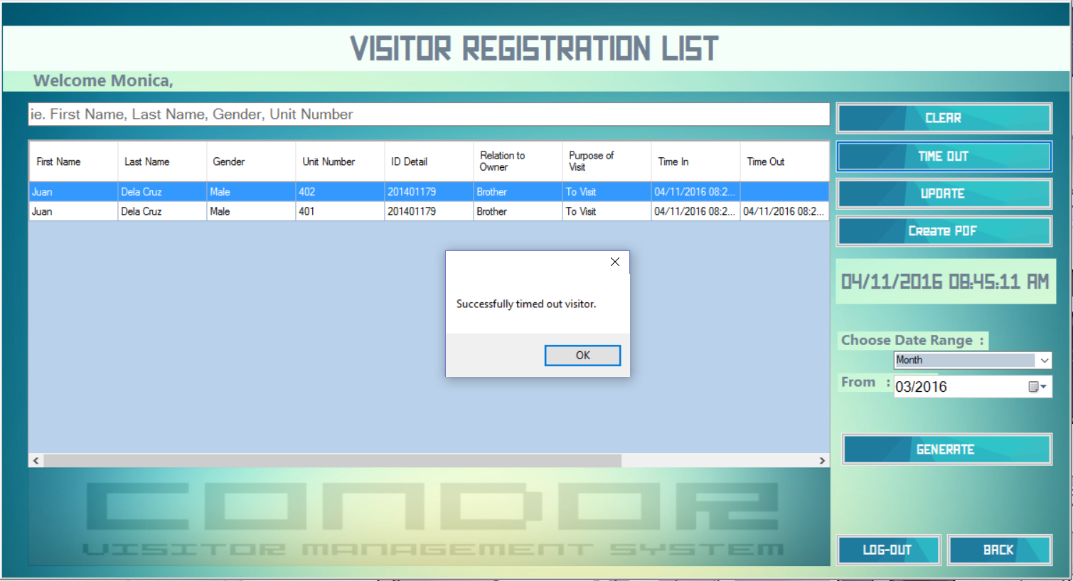

Slide 61
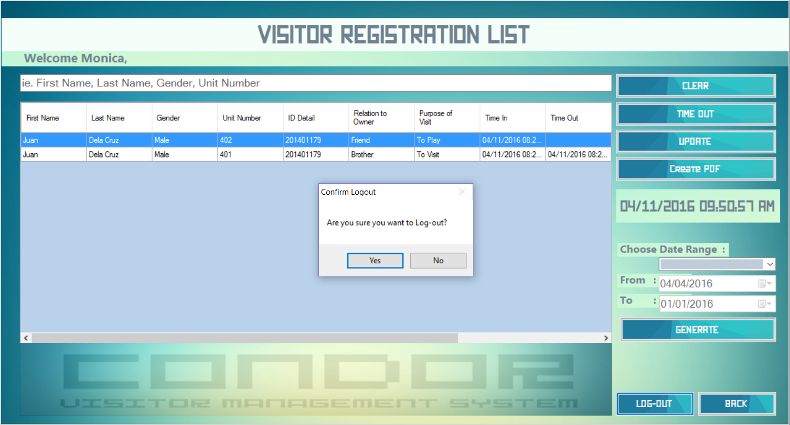

Slide 62
THANK YOU ☺

